Slide 1


CHAPTER 1
Signals and Systems
LOGO
BUSINEBSS REPORT

Slide 2
1
Definition and Classification of Signals
Transformations of the Independent Variable of Signals
2
Representation of Signals Using Basic Functions
Content
3
Concept and Interconnections of Systems
4
Basic System Properties and Classification of Systems
5

Slide 3


1.1 Definition and Classification of Signals
1
Signals are functions with one or more independent variables that typically carry some type of information.
The smoke of wolves’ dung burnt at border posts in ancient China to signal alarm

Slide 4
1.1 Definition and Classification of Signals
2
Signals and Information!

Slide 5
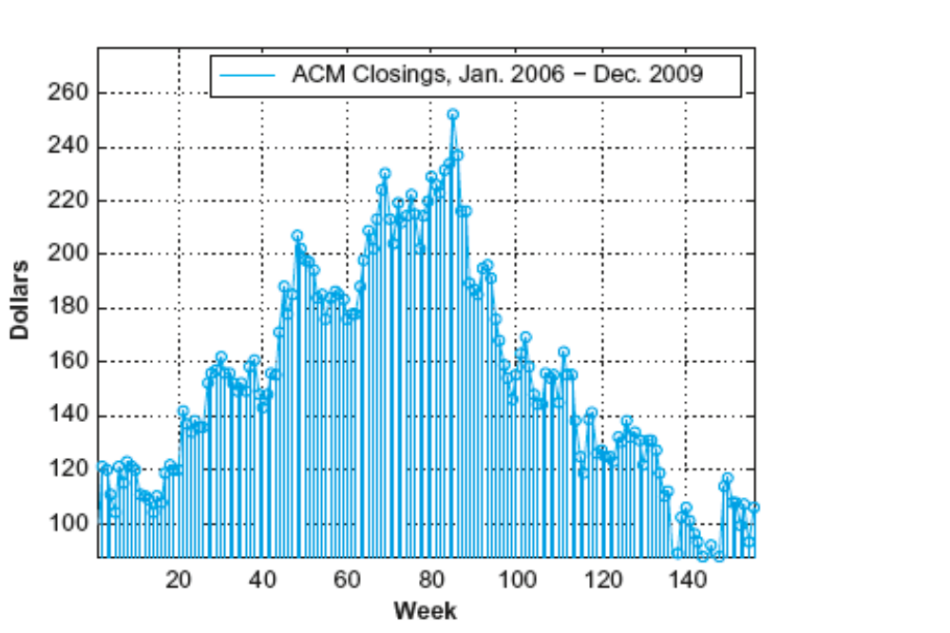
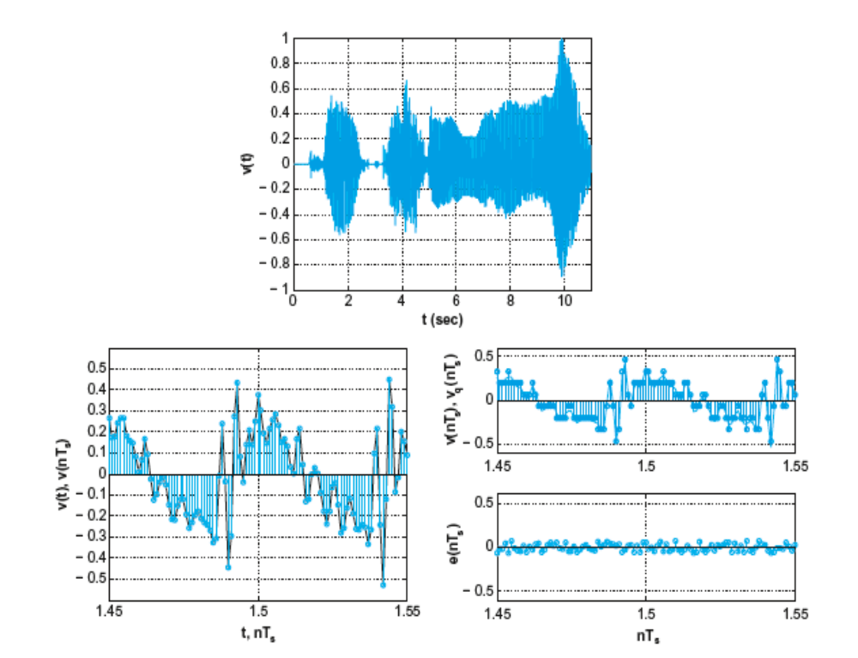
1.1 Definition and Classification of Signals
3
1.1.1 Continuous-time and Discrete-time Signals
（连续时间和离散时间信号）
Continuous-time signals’ independent variable is continuous : x(t) = e^{-t}
Discrete-time signals are defined only at discrete times : x[n] =2n
A segment of the voice signal
Weekly closings of ACM stock for 160 weeks in 2006-2009

Slide 6
Representing Signals Graphically
1.1 Definition and Classification of Signals
4
x(t)
x[n]
x[4]
x[0]
-3
-1
n
-4
-2
0 1 2 3 4 5
t
x[-1]
0
(a)
(b)
Figure 1.1 Graphical representations of
(a) continuous-time and (b) discrete-time signals

Slide 7
1.1 Definition and Classification of Signals
5
1.1.2 Periodic and Non-periodic Signals
（周期和非周期信号）
If there is a positive value of T such that
x(t) = x(t + T)
for all values of t.
If there is a positive integer of N such that
x[n] = x[n + N]
for all values of n.
We say that x(t) (x[n]) is periodic with period T(N).

Slide 8
Example 1.1 Determine the fundamental period of the signal x(t) = 2cos(10πt +1) − sin(4πt − 1).
1.1 Definition and Classification of Signals
6
Sol: Let x₁(t)=2cos(10πt+1), x₂(t)= sin(4πt-1)
T₁=1/5, T₂=1/2
What about the fundamental period T_{x} of x(t)?
Since both T₁ and T₂ are rational, they have the lowest common multiple (LCM: 最小公倍数) , and LCM of T₁ and T₂ is 1, thus
T_{x}=1
If T₁ or T₂ is irrational, x(t) is non-periodic. Because we can not find the LCM of T₁ and T₂. For example, y(t) = 2cos(t+1)-sin(πt-1) is non-periodic.
However, if let π≈3.14, y(t) is periodic. And since ω₁:ω₂ =1:3.14 =50:157 =m₁:m₂, the fundamental period T =m₁T₁= m₂T₂. Thus for y(t),
T_{y}=50×2π=100π=314 or T_{y}=157×2=314 .
Notes:
1、工程中pi只能用有限位数值表示，因此工程中x(t)是周期的
2、工程中的周期信号与数学上定义的周期信号差别：不可能发生于-∞，必然有开始出现的时间-0时刻，因此工程中的周期信号称为单边的，或因果的，或有始的

Slide 9
1.1 Definition and Classification of Signals
7
1.1.3 Determinate and Random Signals
（确定信号和随机信号）
A determinate signal — x(t) = e^{-t}cos (πt)
A random signal — cannot find a function to represent it

Slide 10
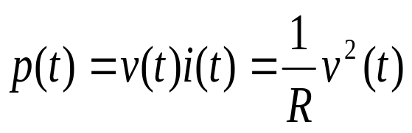
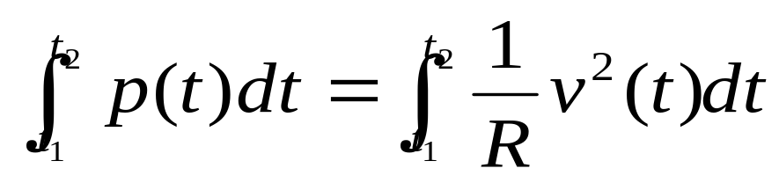
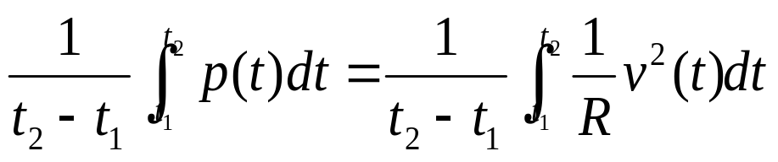
1.1 Definition and Classification of Signals
8
1.1.4 Energy and Power Signals （能量信号和功率信号）
对于某一电阻R上的电压和电流
The instantaneous power（瞬时功率）is
The total energy over
time interval (t₁,t₂) is
The average power in
this interval is

Slide 11
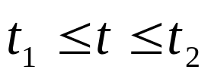
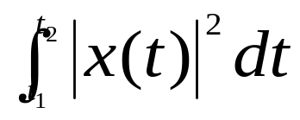

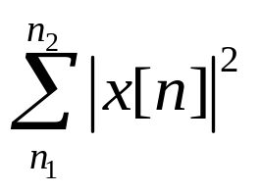
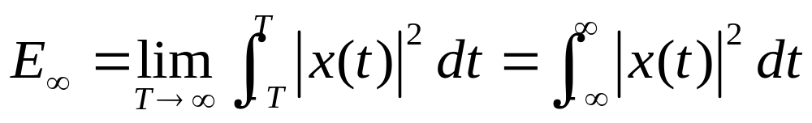
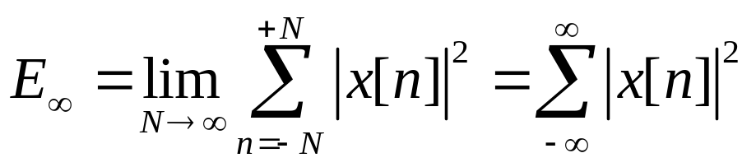
1.1 Definition and Classification of Signals
9
Generally, the total energy over the time interval
for a continuous-time signal:
Similarly, the total energy in a discrete-time signal x[n] over the time interval :
The total energy over an infinite interval is,
in continuous time,
in discrete time,

Slide 12
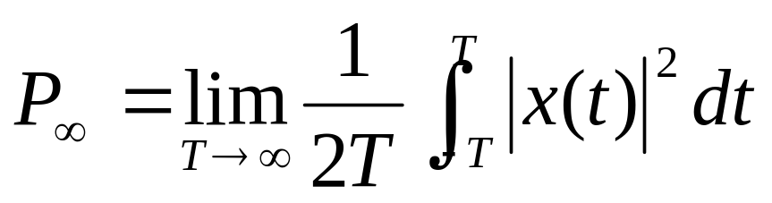
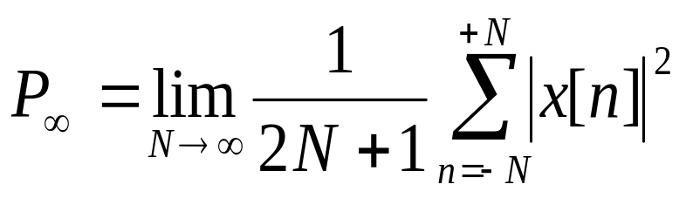
The time-average power over an infinite interval:
1.1 Definition and Classification of Signals
10
in continuous time and discrete time, respectively. With these definitions, we can identify three important classes of signals:
Energy signals (Energy finite signals)
Power signals (Power finite signals)
Signals with neither finite total energy nor finite average power
Notes:
工程中的信号只能是前两类中之一。因为对实际信号的建模一定考虑尽可能用简单的模型，如果一个模型无法全面描述，就用分段方式表示。

Slide 13
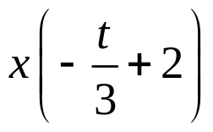
1.2 Transformations of the Independent Variable of Signals
11
Time shift (时移): x(t-t₀) or x[n-n₀] (n₀ is an integer)
Time reversal (反转) : x(-t) or x[-n]
Time scaling (尺度变换): x(at) or x[an] (The factor a is real)
Example 1.2 Signal is shown in the following figure, draw the graph of x(t).
x(t/3+2)
x(t+2)
x(-t/3+2)
1
1
1
-2 -1 0
-2/3 -1/3 0
0 1 2 t
x(t)
1
0 4/3 5/3 2
Notes:
Give more explanation about this!

Slide 14
1.2 Transformations of the Independent Variable of Signals
12
x(-t/3)
1
-6 -5 -4 0
x(t)
x(t/3)
1
1
0 4/3 5/3 2
0 4 5 6

Slide 15
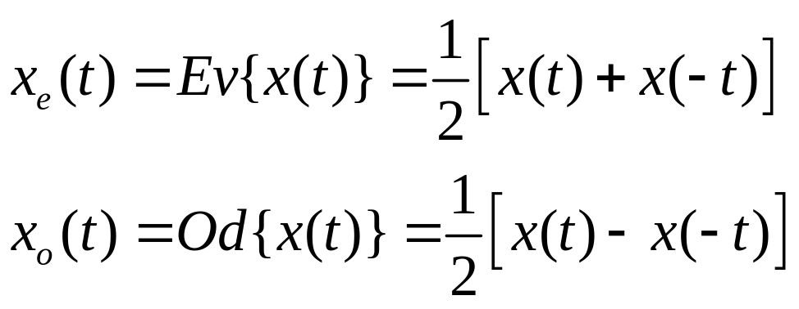
Even and Odd Signals, Even-odd Decomposition of a Signal
1.2 Transformations of the Independent Variable of Signals
13
x (t) = x_{e}(t) + x_{o}(t)
even part of x (t)
odd part of x (t)
Since x (-t) = x_{e}(-t) + x_{o}(-t) = x_{e}(t) - x_{o}(t)

Slide 16
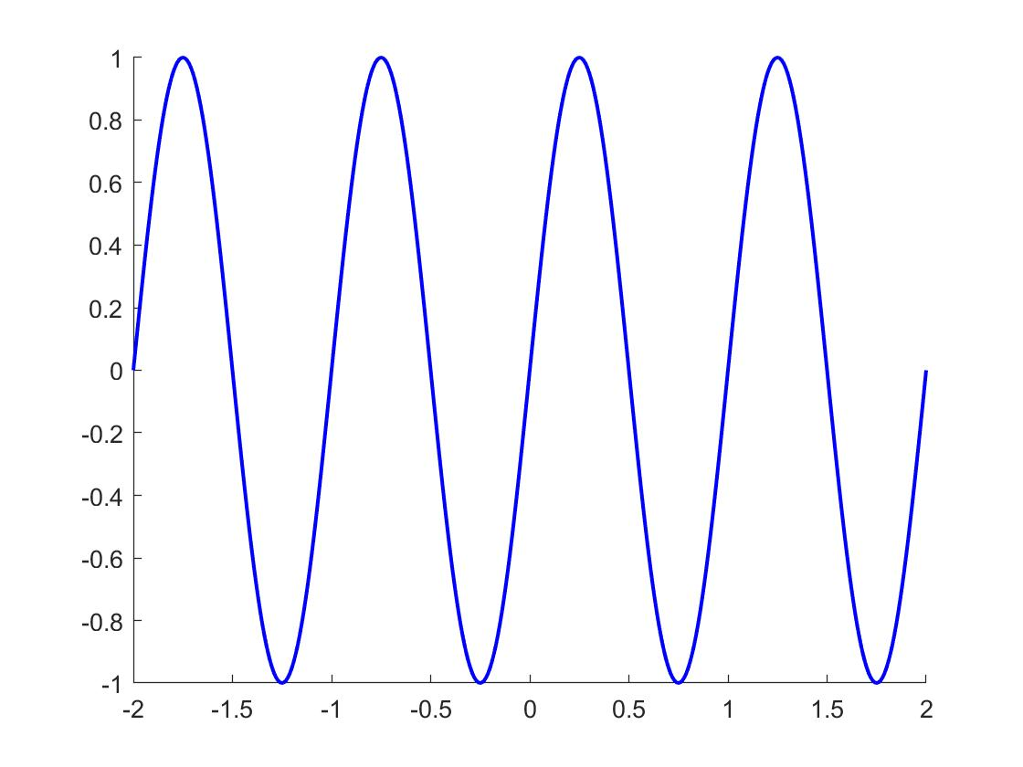
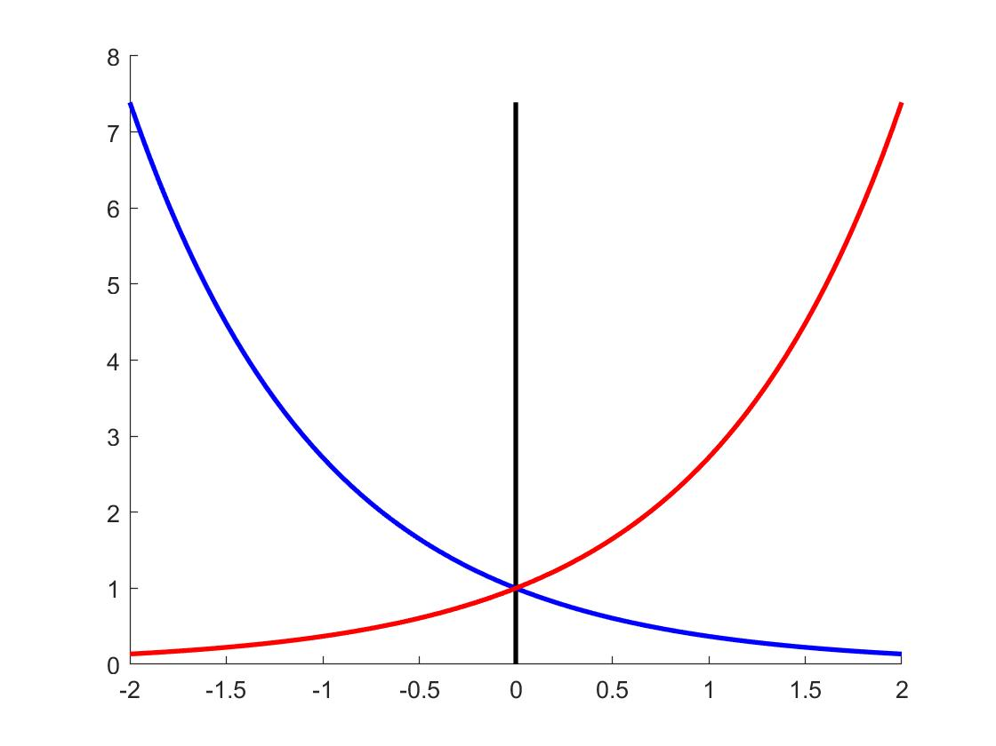
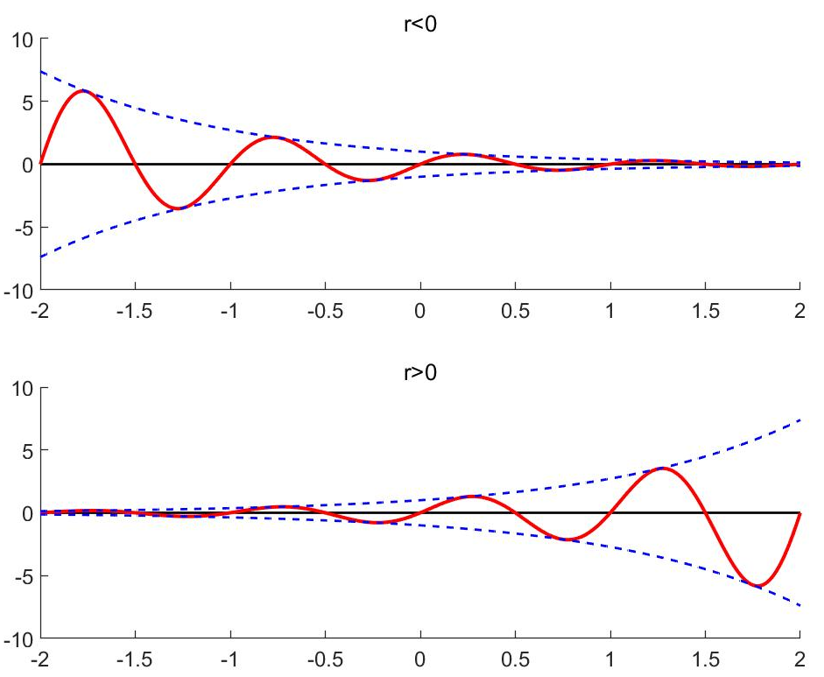
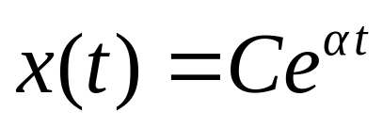
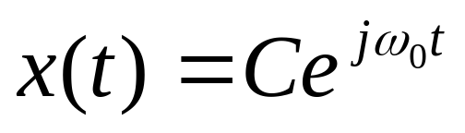
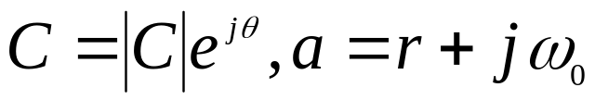
1.3 Representation of Signals Using Basic Functions
14
1.3.1 Continuous-time Complex Exponential （复指数函数） and Sinusoidal Signals（正弦信号）
General form of complex exponential signals:
Real Exponential Signals: Both C and α real
Periodic Complex Exponential: C real and α purely imaginary
periodic complex exponential
General Complex Exponential Signals: Both C and α are complex numbers
Notes:
结合本小节标题说明本节只介绍两大类基本函数，且只解决了任意离散信号如何用δ[n]表示的问题！连续信号用δ(t)表示的问题在下一章解决。信号用复指数函数表示的问题后面章节一一解决。

Slide 17
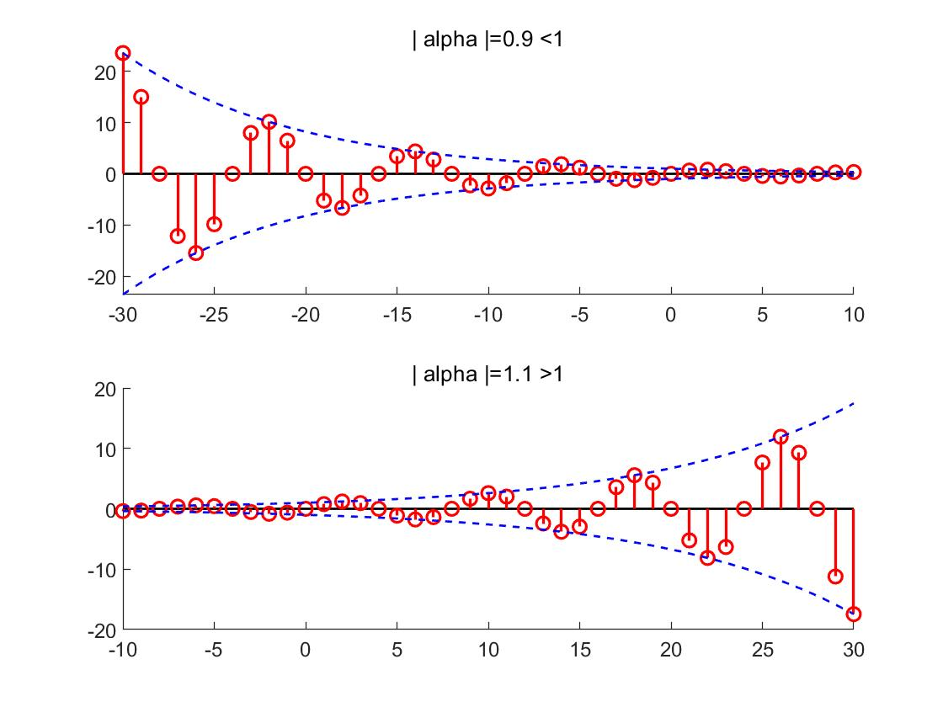
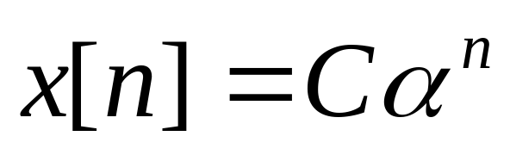


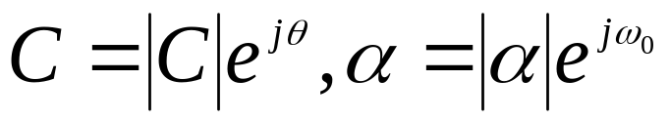


1.3 Representation of Signals Using Basic Functions
15
1.3.2 Discrete-Time Complex Exponential and Sinusoidal signals(sequences)（序列）:
Real Exponential Signals: Both C and α are real
General Complex Exponential Signals: both C and α are complex numbers

Slide 18
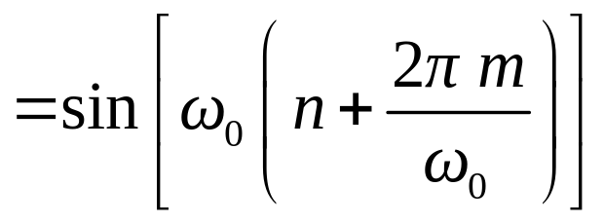
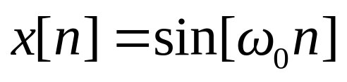
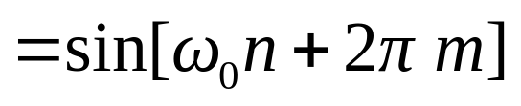
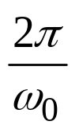
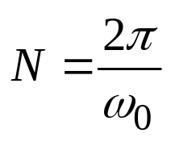
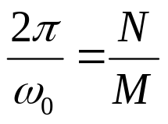
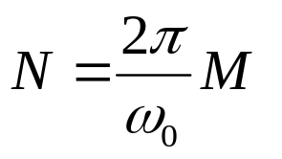
1.3 Representation of Signals Using Basic Functions
16
1.3.3 Periodicity Property of Discrete-Time Complex Exponentials（离散复指数序列的周期性）
A discrete-time sinusoidal signal
Three cases for the periodicity of the sequence:
is an integer, the fundamental period
is a rational number, the fundamental period
is an irrational number, the sequence is not periodic.

Slide 19
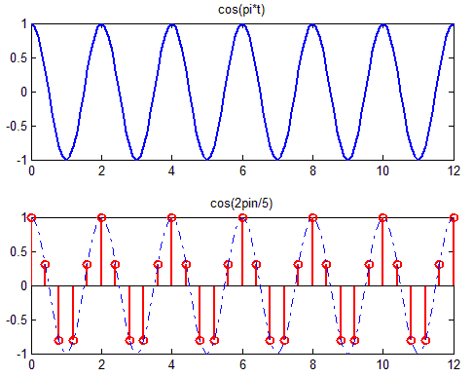
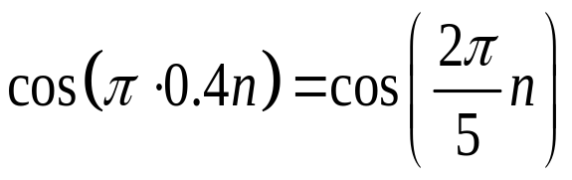
Sampling cos(πt) with Different Periods Leading to Different Results
1.3 Representation of Signals Using Basic Functions
17
Sampling cos(πt) with period T_{s} = 0.4 s produces
N = 5
Notes:
连续的和离散的三角函数表达式中ω的不同含义！

Slide 20
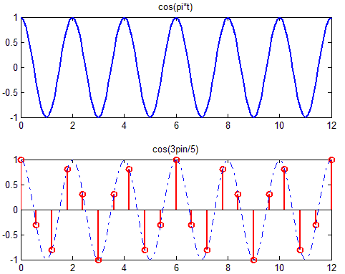
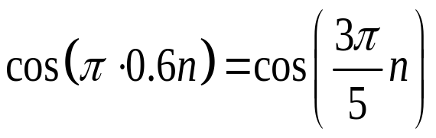
1.3 Representation of Signals Using Basic Functions
18
Sampling cos(πt) with period T_{s} = 0.6 s produces
N = 10

Slide 21
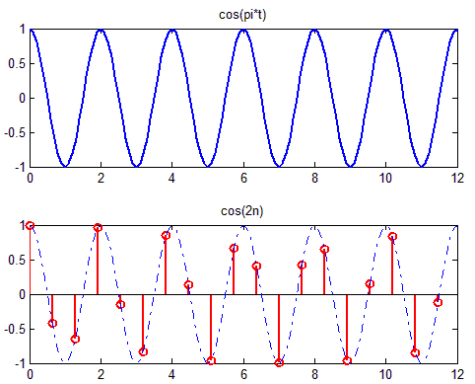
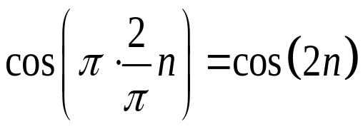
1.3 Representation of Signals Using Basic Functions
19
Sampling cos(πt) with period T_{s} = 2/π s produces
Nonperiodic !

Slide 22
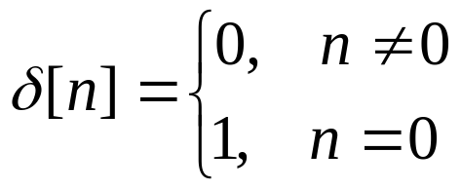
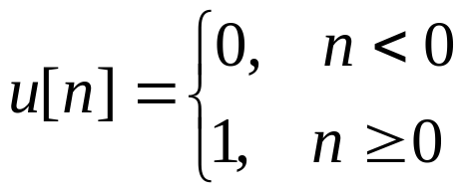



unit impulse (or unit sample):
单位脉冲（单位样本）
1.3 Representation of Signals Using Basic Functions
1.3.4 The Discrete-Time Unit Impulse and Unit Step Sequences （单位脉冲和单位阶跃序列）
unit step:
1
1
n
0
n
0
shifted unit sample:
1
n
k

Slide 23

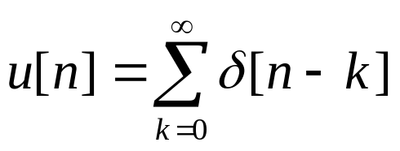
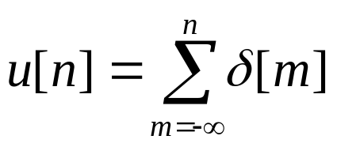


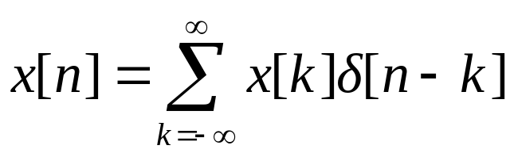
1.3 Representation of Signals Using Basic Functions
Relationship between unit sample and unit step
unit sample is the first difference（一阶差分）of the unit step
unit step is the running sum （连续求和） of the unit sample
sampling property （抽样性质）of unit sample:
Representing an arbitrary discrete-time signal in terms of shifted unit sample as (Signal Decomposition):

Slide 24

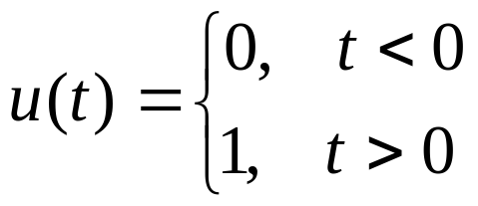

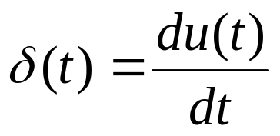
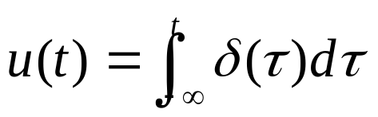
1.3 Representation of Signals Using Basic Functions
1.3.5 The Continuous-Time Unit Step and Unit Impulse Functions
unit step function:
u(t)
1
(1)
0
unit impulse function:
t
0
Relationship between unit impulse and unit step

Slide 25
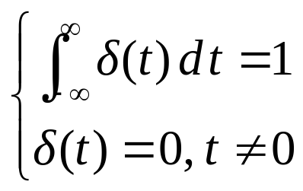
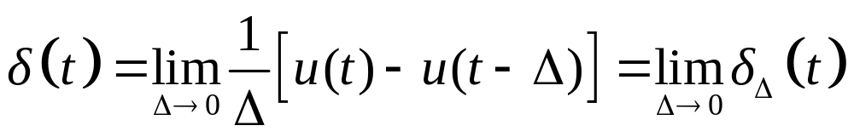
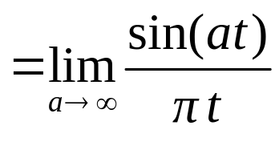
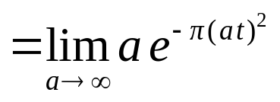
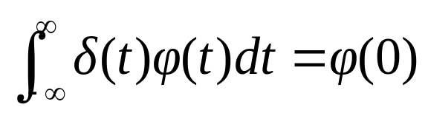
1.3 Representation of Signals Using Basic Functions
Definition of unit impulse
Dirac definition:
Limit definition:
Gaussian function
Rectangular function
Sampling function
Generalized function （广义函数）definition:
Notes:
广义函数定义亦可称为分配函数（Distribution Function）定义。 x(t)称为检验函数（test function）。
广义函数N_{g}[φ(t)]: 选择一类性能良好的函数φ(t)作为检验函数，一个广义函数g(t)对检验函数空间中的每个函数φ(t)赋以一个数值N的映射，记为𝑁_(𝑔 ) [𝜑(𝑡)]=∫24_(−∞)^∞▒𝑔(𝑡)𝜑(𝑡)𝑑𝑡

Slide 26
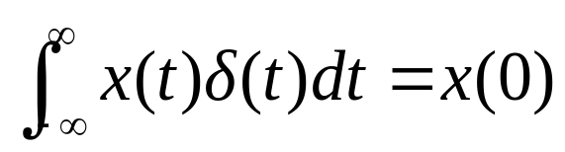





1.3 Representation of Signals Using Basic Functions
Property of unit impulse
Multiplication property and Sampling property
δ(t) is a even function
Scaling property

Slide 27


Example 1.3 Determine and sketch the derivative of x(t) depicted in the following figure.
1.3 Representation of Signals Using Basic Functions
x(t)
1
1
0 1 2 4
t
0 1 2 4
-1
-1
-2

Slide 28




1.4 Concept and Interconnections of Systems
In broad sense, physical systems are an interconnection of components, devices or subsystems.
In contexts from signal processing to communications, a system can be viewed as a process in which input signals are transformed by the system or cause the system to respond in some way, resulting in other signals as outputs.
Input
System
Output
Continuous-time system: both input signals and output signals are continuous-time signals: x(t) → y(t)
Discrete-time system: transform discrete-time inputs into discrete-time outputs: x[n] → y[n]
Notes:
说明这门课程重点放在“系统分析”而非“系统综合设计”
差分举个例子

Slide 29
Basic interconnections of subsystems
1.4 Concept and Interconnections of Systems
series or cascade interconnection（串联或级联互连）
Input
System 1
System 2
Output
parallel interconnection （并联互连）
System 1
Input
Output
System 2

Slide 30
1.4 Concept and Interconnections of Systems
complicated interconnections which combine the former two interconnections （混合互连）
System1
System 2
Input
Output
System 4
System 3
feedback interconnection（反馈互连）
Input
System 1
Output
System 2

Slide 31






1.5 Basic System Properties and Classification of Systems
Systems with and without Memory
(有记忆系统和无记忆系统，有记忆系统也称为动态系统)
A system with memory means it can retain or store information about input values at times other than the current time.
example:
Memoryless
With memory
Invertibility and Inverse Systems (可逆性和逆系统)
A system is said to be invertible if distinct inputs lead to distinct outputs.
example:
Non-Invertible
Invertible
Notes:
组合电路是无记忆系统；时序电路是有记忆系统，后者可实现的功能往往更多！
工程中往往需要设计可逆系统，例如调制-解调；加密-解密；压缩-解压。。。

Slide 32



1.5 Basic System Properties and Classification of Systems
Causality (因果性)
A system is causal if the output at any time depends only on values of the input at the present time and in the past.
example:
Non-causal
Causal
Stability (稳定性)
If the input to a stable system is bounded (i.e., if its magnitude does not grow without bound), then the output must also be bounded (BIBO Stability).
example:
Stable
Unstable
Notes:
依据已知的不同条件，判断因果性有不同方法；稳定性也是！
y[n]=x[-n] 不可能是实时系统，其因果性不重要！只有实时系统才强调因果性！

Slide 33






1.5 Basic System Properties and Classification of Systems
Time Invariance (时不变性)
A system is time invariant if the behavior and characteristics of the system are fixed over time.
example:
Sol:
However,
Time-varying
Notes:
判断时不变性不能机械地做数学替换，要根据输入-输出关系理解系统功能，例如y[n]=x[-n]，对于x[n-m]，其输出y2[n]=x[-n-m]

Slide 34










1.5 Basic System Properties and Classification of Systems
Linearity (线性) = additivity + homogeneity
（可加性） （齐次性）
Continuous-time:
Discrete-time:
example:
Sol:
Let
Nonlinear !
Zero-input response
Incrementally linear system(增量线性系统)
Zero-state response
y₀[n] = 5
+

Slide 35
Example:
Consider an LTI system whose response to the signal x₁(t) in Figure (a) is the signal y₁(t) illustrated in Figure (b). Determine and sketch the responses of the system to the inputs x₂(t) and x₃(t) depicted in Figure (c) and (d) respectively.
x₂(t)
x₃(t)
x₁(t)
2
1
1
1
0 1 2 3 4 t
-1
-1 0 1 2 t
0 1 2 t
Figure (d)
Figure (a)
Figure (c)
y₂(t)
y₁(t)
y₃(t)
2
2
2
1
1
1
0 1 2 3 4 t
0 1 2 t
-1 0 1 2 t
Figure (b)

Slide 36
1.6 SUMMARY
The concepts of signals and systems ;
The graphical and mathematical representation of signals ;
The classifications of signals ;
Transformations of the independent variable of signals ;
Two type of basic signals ;
Representation of arbitrary discrete-time signals as sum of δ function;
Properties of systems .

Slide 37
Homework
1.22 (d)(h) 1.23 (b) 1.24 (a) 1.25 (b) (d) (f) 1.26 (b) (d) (e) 1.27 (b) (e) (f) 1.28 (b) (c) (e)

